Slide 1
IBM University Engagement Project Submission
“Exploring the Power of Agentic AI with IBM Granite and LangFlow”

Slide 2

Project Tile – [Recipe Preparation Agent]
Domain of Project – [ Food Technology]
Student Name | Recent Passport Photo | Email ID | Mobile number [WhatsApp]
Arfa. M. Mulla |  | arfamohmmadi005@gmail.com | 8867575941

Slide 3
Problem Statement -
Problem Statement: 16 – Recipe Preparation Agent
The Challenge
Cooking nutritious and delicious meals becomes difficult when individuals have limited ingredients available at home. People often struggle to decide what to cook, find suitable recipes, and identify alternatives when certain ingredients are missing. Without personalized recipe suggestions and proper cooking guidance, available groceries may go unused, leading to food waste and unnecessary expenses. Accessing recipes from multiple sources can also make meal preparation time-consuming and confusing.
The Objective
Build an AI-powered Recipe Preparation Agent that helps users prepare meals using the ingredients they already have. The solution should:
Ingredient-Based Recipe Suggestions – Recommend recipes based on available groceries and ingredients entered by users.
Recipe Data RAG Retrieval – Retrieve relevant recipes from a reliable recipe knowledge base and generate suitable cooking instructions using Retrieval-Augmented Generation (RAG).
Step-by-Step Cooking Instructions – Provide simple, easy-to-follow cooking instructions with preparation time, cooking time, and required quantities.
Ingredient Substitutions – Suggest alternative ingredients when certain items are unavailable and adapt recipes based on ingredient limitations.
Dietary Preferences & Adjustments – Recommend recipes based on vegetarian preferences, allergies, dietary restrictions, and food choices.
Multi-Agent System –
Recipe Knowledge Agent – Retrieves relevant recipes and cooking information.
Recipe Recommendation Agent – Suggests recipes based on available ingredients.
Cooking Assistance Agent – Provides step-by-step instructions, cooking tips, and preparation guidance.
Food Waste Reduction – Encourage users to utilize available ingredients effectively, minimize food waste, and save time and money.

Slide 4
Proposed Solution -
Proposed Solution: AI-Powered Recipe Preparation Agent
The proposed solution is an AI-powered Recipe Preparation Agent built using IBM watsonx.ai, IBM Granite Models to help users prepare meals using the ingredients they already have. The system addresses challenges in meal planning, food waste reduction, and finding suitable recipes through an intelligent, AI-powered architecture.
At its core, the system uses a Retrieval-Augmented Generation (RAG) pipeline to retrieve relevant recipes from a recipe knowledge base based on the ingredients available to the user. This recipe data is stored in a searchable database, enabling IBM Granite models to retrieve, understand, and generate suitable recipes with step-by-step cooking instructions.
The system consists of four key components:
Recipe Knowledge Agent retrieves relevant recipes from the recipe database based on the ingredients provided by users and summarizes the available cooking options.
Recipe Recommendation Agent suggests personalized recipes based on available ingredients, food preferences, cuisine choices, and dietary requirements.
Ingredient Substitution Agent recommends alternative ingredients when some required ingredients are unavailable and provides suitable substitutions without affecting the recipe significantly.
Cooking Assistance Agent generates step-by-step cooking instructions, preparation tips, cooking time, and suggestions for adjusting recipes according to user preferences.
The solution includes a user-friendly dashboard where users can enter available ingredients and view recommended recipes, required ingredients, cooking instructions, substitutions, and helpful cooking tips.
IBM watsonx.ai is used to access and deploy AI models, while IBM Granite powers recipe understanding, recommendation, summarization, and personalized cooking guidance. RAG enables the system to retrieve relevant recipes from the recipe knowledge base and generate responses based on the retrieved information.
Overall, this solution delivers an intelligent recipe preparation assistant that helps users prepare delicious meals using available ingredients, reduces food waste, saves cooking time, and makes everyday meal preparation smarter, simpler, and more convenient.
Important for your actual implementation: This is a proposed architecture. We can build a simplified working version first, using a small recipe knowledge base, IBM Granite. We should not claim that all four agents or a full vector database are implemented unless we actually build them.

Slide 5
Technology Used
IBM Granite model -For example - ibm-granite-3-2-8b, For natural language understanding, reasoning, recipe recommendations, and personalized cooking instructions.
IBM Cloud – It provides the infrastructure to build, deploy, and scale the Recipe Preparation Agent efficiently. IBM Cloud enables a reliable, secure, and scalable environment for deploying the Recipe Preparation Agent.
RAG– RAG is used to fetch relevant recipes first, then generate intelligent answers, making the Recipe Preparation Agent more trustworthy and effective.
IBM Watsonx.ai - For IBM Granite model access, model deployment, and AI-powered recipe generation.
Vector Database (FAISS/Chroma) – For RAG-based recipe retrieval and storing recipe embeddings to find relevant recipes based on the ingredients provided by users.
Flask – For developing the backend and connecting the user interface, RAG system, and IBM Granite model.

Slide 6
Langflow component Used -
1) Chat Input – Interface where users enter available ingredients, food preferences, dietary requirements, and cooking preferences.
2) IBM watsonx AI Agent -Processes user input using IBM Granite models to generate suitable recipes, ingredient substitutions, and cooking recommendations.
3) Name of IBM Granite model - ibm/granite-13b-instruct-v2 → Generates recipe suggestions, understands ingredient requirements, and provides step-by-step cooking instructions.
4) Chat output - Displays AI-generated responses such as recommended recipes, cooking instructions, ingredient substitutions, and cooking tips.
5) File component - Stores and retrieves recipe data from the recipe knowledge base (recipes.json) for relevant recipe recommendations.
6) ChromaDB Retriever / Vector Store – Retrieves relevant recipes using semantic similarity search as part of the RAG pipeline.

Slide 7
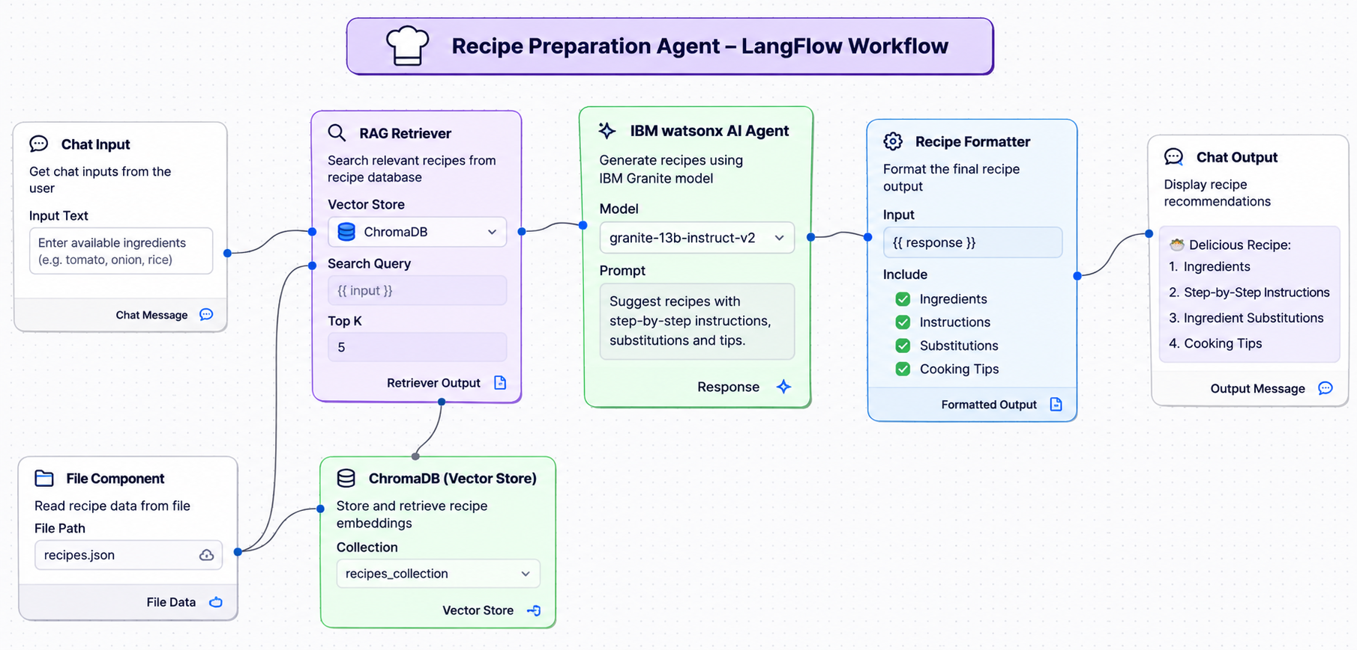
Langflow workflow -

Slide 8
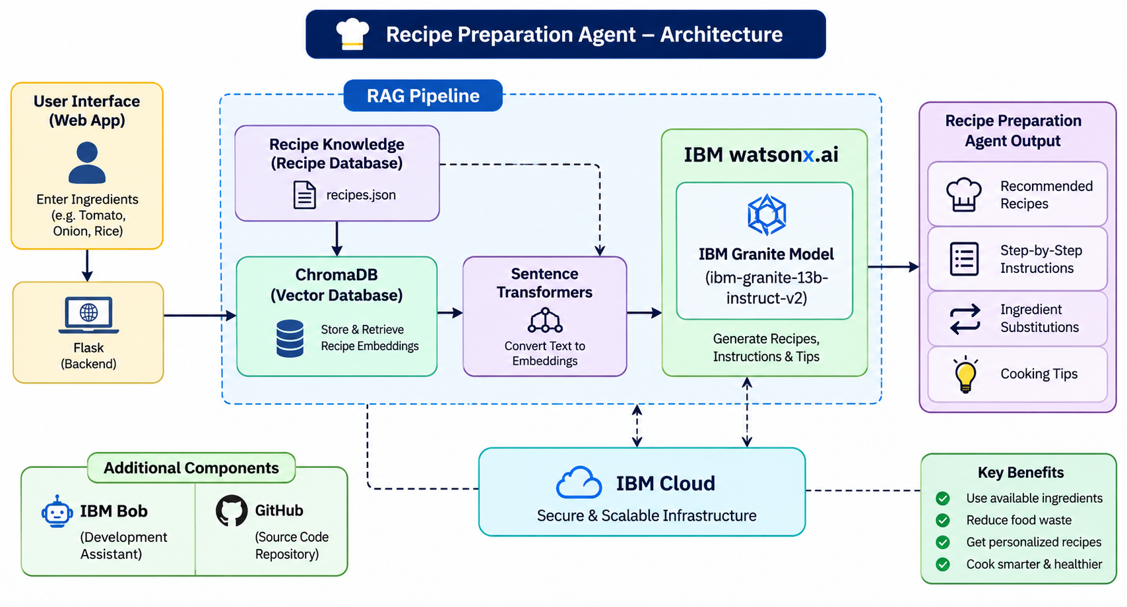
Architecture blueprint

Slide 9

Role of Agentic AI in the solution
Role of Agentic AI in Recipe Preparation Agent
Agentic AI enables the Recipe Preparation Agent to function as an intelligent system rather than a simple chatbot. Using IBM watsonx.ai and the IBM Granite model, it processes user inputs and coordinates different components to provide personalized recipe recommendations.
Each component performs a specific role—such as retrieving relevant recipes, generating cooking instructions, suggesting ingredient substitutions, and providing cooking tips—while working together. This RAG-based approach ensures relevant information is retrieved before generating useful responses.
Agentic AI also brings context awareness, understanding user inputs such as available ingredients, food preferences, and dietary requirements to generate suitable recipe suggestions. It supports real-time adaptation, updating recommendations based on the ingredients and preferences provided by users.
Additionally, the system combines retrieved recipe information with the user's requirements, enabling better recipe selection and more useful cooking guidance.
Overall, Agentic AI makes the system intelligent, personalized, and goal-driven, acting like a smart digital cooking assistant that helps users prepare meals easily, make better use of available ingredients, and reduce food waste.

Slide 10
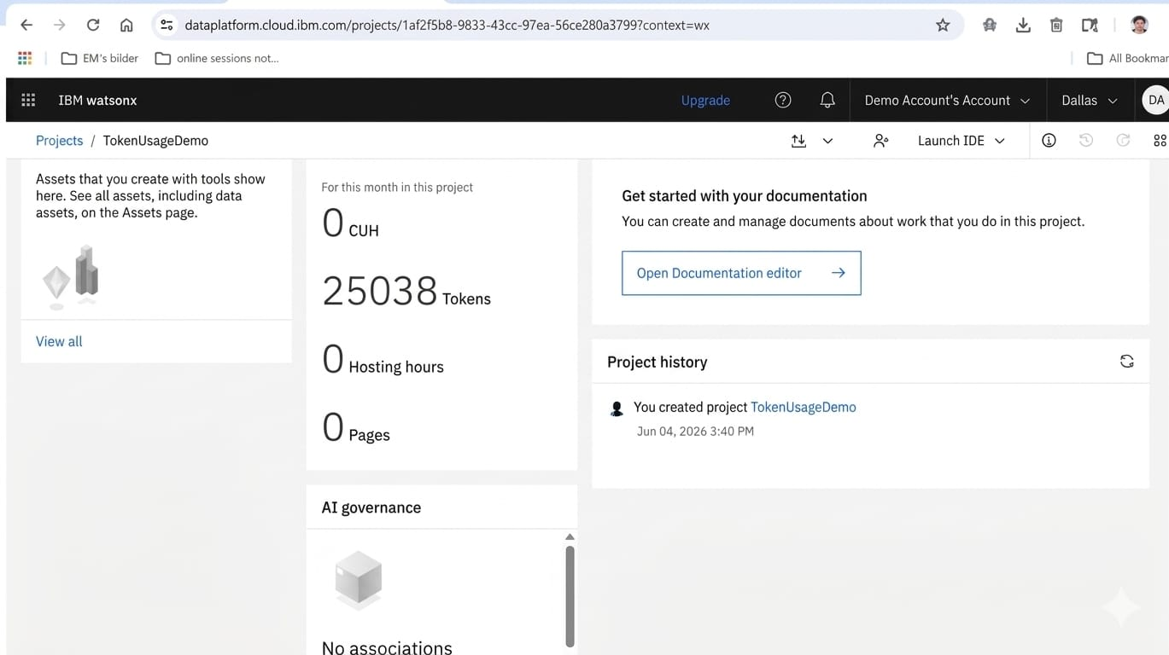
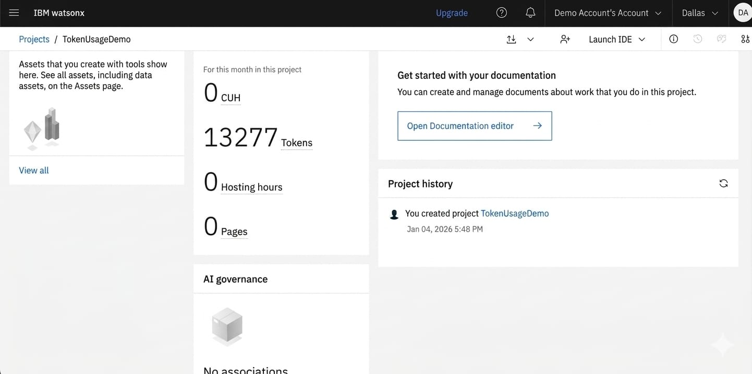
Token Usage
11,761 token are used
Before Prompt
After the Prompt
·
·
·

Slide 11
Novelty and Uniqueness
The proposed Recipe Preparation Agent stands out by combining Agentic AI, RAG, and personalization into a single intelligent system.
Intelligent Recipe Generation – Uses IBM Granite to generate suitable recipes and step-by-step cooking instructions based on the ingredients provided by users.
RAG-Based Accuracy – Retrieves relevant recipes from the recipe knowledge base using ChromaDB before generating responses, ensuring more relevant and reliable cooking suggestions.
Ingredient-Based Personalization – Recommends recipes based on available ingredients, user preferences, and dietary requirements.
Smart Ingredient Substitution – Suggests alternative ingredients when users do not have all the required items, making cooking more flexible.
Cooking Assistance – Provides step-by-step instructions, useful cooking tips, and guidance to help users prepare meals easily.
Food Waste Reduction – Encourages users to make better use of available ingredients by suggesting suitable recipes and alternatives.
IBM-Powered Architecture – Built using IBM watsonx.ai and IBM Granite models, with Flask, RAG, and ChromaDB to support intelligent recipe retrieval and generation.
This makes the solution a smart, flexible, and personalized digital cooking assistant, not just a basic recipe recommendation tool.

Slide 12
Git Hub Link
https://github.com/Arfa029/AICTE-BOB-Recipe-maker
·
·

Slide 13
Future Scope
1. Integration with Smart Kitchen Devices –
The system can be integrated with smart kitchen appliances such as smart ovens, cookers, and kitchen scales to provide better cooking assistance. This will help users receive cooking time, temperature, and portion recommendations based on selected recipes, making the cooking process easier and more efficient.
2. AI-Powered Voice Assistant & Multilingual Support –
Enhancing the system with a voice-enabled assistant and support for multiple languages will improve accessibility. Users can speak their available ingredients, ask for recipe suggestions, and receive step-by-step cooking instructions in their preferred language, making the solution more user-friendly and inclusive.
·
·

Slide 14
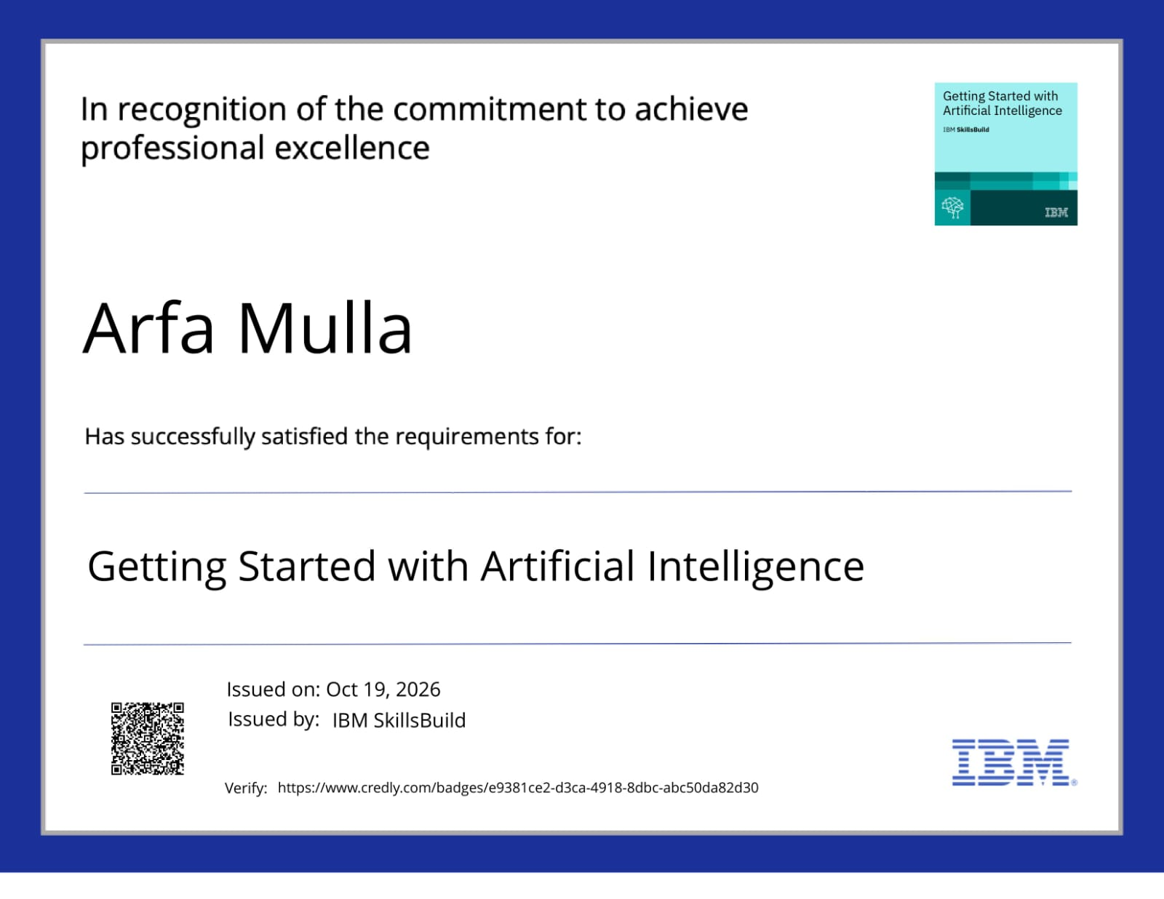
Certificates Earned:
Please add your credly certificate

Slide 15
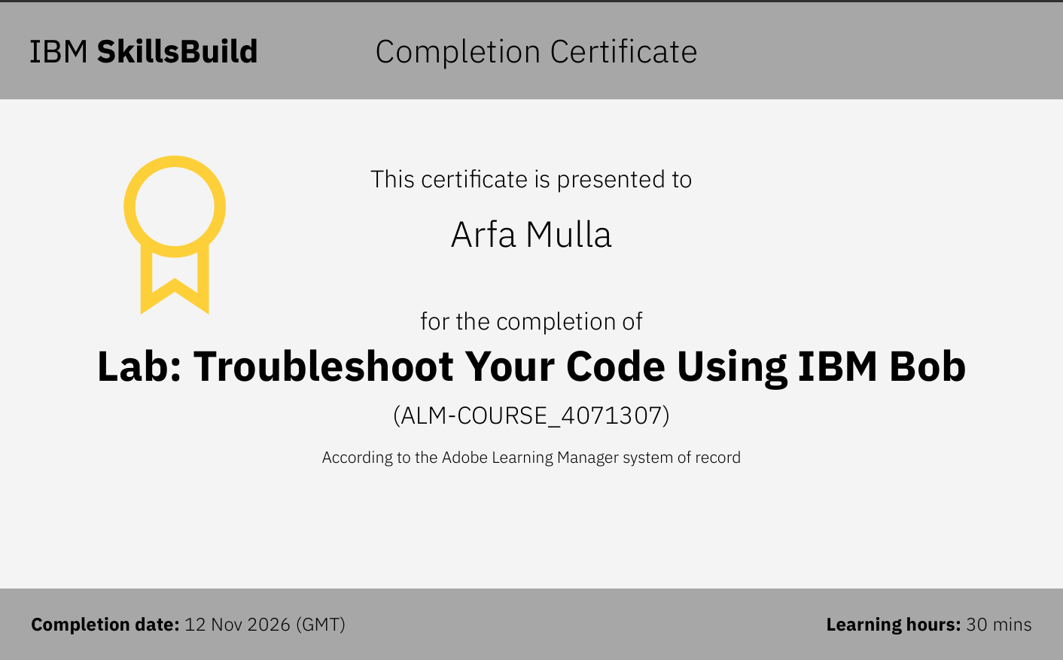
Certificates Earned:​
Add your IBM BOB Certificate

Slide 16


